Slide 1


Welcome to Shopist
Our very own e-commerce web development project. Created by divyanshu rai, Shaurya omar and shivam Tiwari.

Slide 2
Objectives
This project was solely developed to provide the customers a good online purchase experience in the times of Amazon and Flipkart.
This website will provide all the stuff directly from the manufacturers, cutting all the middlemen cost and making it cost effective.
This project is made using the latest technologies, and the backend of the project will contain appropriate load balancing that will handle a large amount of customers at the same time.
The web portal will have an online interface in the form of an e-commerce website that will allow users to buy goods from the merchants and in future, will let people sell stuff too.
The website will provide buyers with information about the various products that are for sale. The information will include prices, product descriptions, stock availability as well as photographs of the products.

Slide 3


Technologies used
HTML
CSS
TypeScript
Angular JS

Slide 4
Expansion of ecommerce industry in 21st century

Slide 5
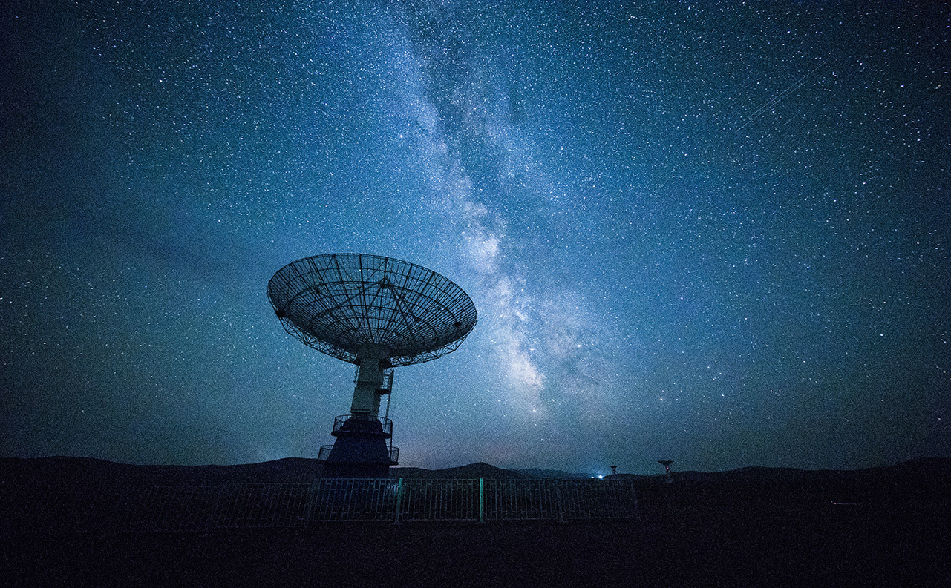
FEASIBILITY OF PROJECT
Prevent customers from fraudulence
Access the Global Market
Facilitate transactions

Slide 6
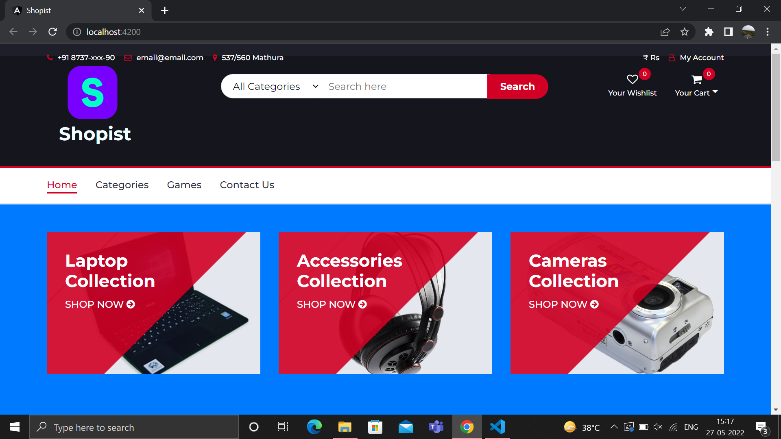
landing page

Slide 7
FUTURE SCOPE
We'll eventually use Node.js to implement an anti-fraud system that will help users make secure transactions.
There is enough scope for online businesses in the future if clients understand the Indian shoppers’ psyche and cater to their needs.
Online storefronts are open 24/7 to serve customers – no more worrying about missing out because of holidays, strikes, or even lockdowns. So it means that our e-commerce website portal will prove to be even more fruitful than any other offline/window store.
In the coming time we will add a database of merchandise with photos, product descriptions and stock information. This database will also contain all relevant merchant and customer information.

Slide 8

Thank You!
SHIVAM TIWARI – 191500763 (k)
SHAURYA OMAR – 191500278(l)
DIVYANSHU RAI – 191500278(m)

